Slide 1



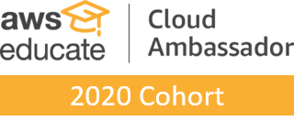
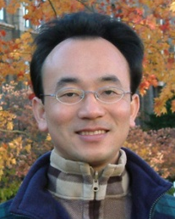
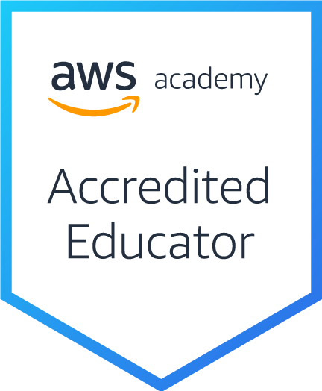
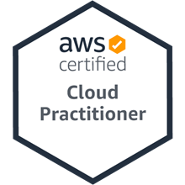
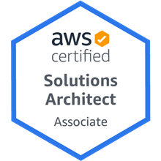
AWS Educate 2021 Q2 Online Educator Meetup
AWS Academy 教學經驗分享
國立臺北大學企管系選修課程 (企業雲端運算入門)
(Teaching Experiences Sharing of Introducing AWS Academy at NTPU: Foundation of Business Cloud Computing)
Time: 2021/7/5 (Mon) 10:50-11:20 am
Host: AWS Educate
戴敏育 副教授
Min-Yuh Day, Ph.D, Associate Professor
國立臺北大學 資訊管理研究所
Institute of Information Management, National Taipei University
https://web.ntpu.edu.tw/~myday
2021-07-05

Slide 2


戴敏育 博士 (Min-Yuh Day, Ph.D.)
1
國立臺北大學 資訊管理研究所 副教授
中央研究院 資訊科學研究所 訪問學人
國立臺灣大學 資訊管理 博士
Publications Co-Chairs, IEEE/ACM International Conference on Advances in Social Networks Analysis and Mining (ASONAM 2013- )
Program Co-Chair, IEEE International Workshop on Empirical Methods for Recognizing Inference in TExt (IEEE EM-RITE 2012- )
Publications Chair, The IEEE International Conference on Information Reuse and Integration (IEEE IRI)

Slide 3

Outline
AWS雲端應用導入教學
課程理論中融入AWS概念
帶領學生進行雲端實作

Slide 4
國立臺北大學 AWS 雲創學院
Amazon Web Services (AWS)
全球廣泛採納的雲端平台，透過全球資料中心提供超過175項功能完整的服務，包含資料庫、運算分析、網路、開發人員工具、資訊安全和企業應用等，不但能在AWS上運行 R, Python, C++ 等程式語言，也可延伸至AI與機器學習、區塊鏈、物聯網、資料湖 (Data Lake)、大數據分析、遊戲開發及電子商務等多樣化的應用情境中。
國立臺北大學推動AWS雲創學院發展
期望鼓勵全校各院系相關課程教師，於教學中導入雲端概念與AWS應用，透過帶領學生實作練習，增進學生學習成效以及 和產業接軌的機會。

Slide 5
AWS雲端應用導入教學
企業雲端運算入門 (Foundation of Business Cloud Computing)
(BA4, NTPU) (Spring 2021)
大數據分析 (Big Data Analytics)
(MBA, IM, NTPU) (Fall 2020)
軟體工程 (Software Engineering)
(MBA, IM, NTPU) (Fall 2020)
雲端服務架構實務 (Cloud Services Architecting Practices)
(MI4, TKU) (Spring 2021, Fall 2020, Spring 2020, Fall 2019)
https://web.ntpu.edu.tw/~myday/teaching.htm

Slide 6
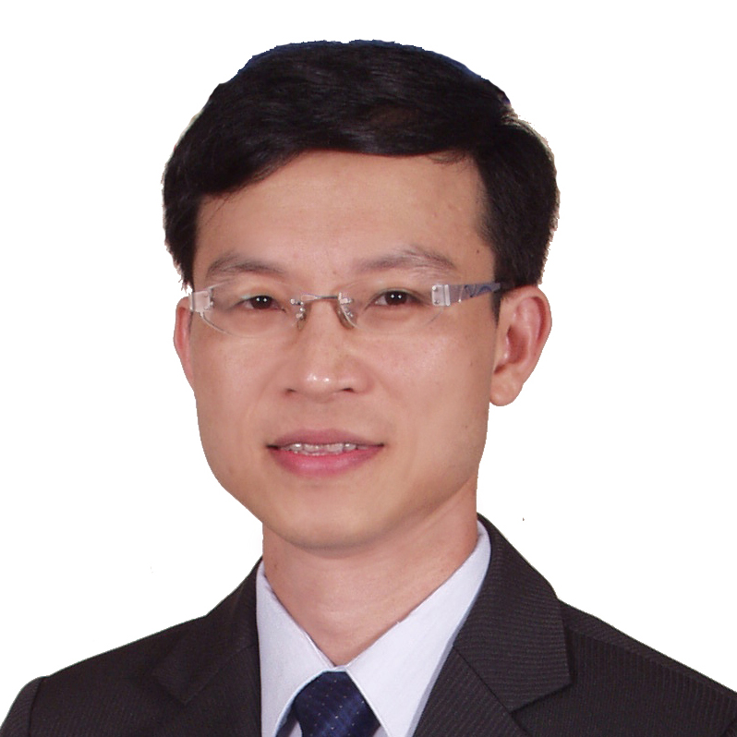
企業雲端運算入門 (Foundation of Business Cloud Computing)
雲端概念概述 (Cloud Concepts Overview)
企業雲端運算入門 (Foundation of Business Cloud Computing) (BA4, NTPU) (Spring 2021)
(AWS Academy Cloud Foundations; ACF) (AWS Certified Cloud Practitioner)
(BA4, NTPU) (3 Credits, Elective) (U4010) (自主學習課程)(商業智慧與大數據分析學士學分學程)
(1092) (國立台北大學企管系4A, 4B) (選修3學分) (授課教師：謝榮桂，戴敏育) (2021.02 - 2021.06)
(週三 Wed, 6, 7, 8, 14:10-17:00) (台北大學三峽校區 文3F10_L)
謝榮桂 (Jung-Kuei Hsieh), 戴敏育 (Min-Yuh Day)
National Taipei University
國立臺北大學
2021-02-24

Slide 8
國立臺北大學 109學年度第2學期 課程大綱 Spring 2021 (2021.02 - 2021.06)
課程名稱 ：企業雲端運算入門 (Foundation of Business Cloud Computing)
應修系級 Major：企業管理學系4A , 4B, 商業智慧與大數據分析學士學分學程
授課教師 Instructor：謝榮桂 戴敏育
選修類別 Required/Elective：選 (Elective)
學 分 Credit(s) ：3 學分
週三 Wed, 6, 7, 8, 14:10-17:00
(台北大學三峽校區 文3F10_L)
(自主學習課程)

Slide 9
教學目標
本課程主要介紹亞馬遜公司的雲端運算服務 Amazon Web Services (AWS)， 對於想要全面瞭解企業雲端運算概念的同學， 本課程將詳細介紹 雲概念、 AWS 核心服務、 安全性、 架構、 定價和相關支援等服務， 並以通過認證 AWS Certified Cloud Practitioner為目標。

Slide 10
Course Objectives
This course introduces Amazon Web Services (AWS), the cloud computing service of Amazon.
For students who want to fully understand the concept of enterprise cloud computing, this course will introduce the AWS Academy Cloud Foundations.
Topics include Cloud Concepts Overview, Cloud Economics and Billing, AWS Global Infrastructure Overview, AWS Cloud Security, Networking and Content Delivery, Cloud Compute, Cloud Storage, Cloud Databases, Cloud Architecture, Cloud Automatic Scaling and Monitoring.
The course objective is training students to pass the certification of AWS Certified Cloud Practitioner.

Slide 11
Course Outline
Cloud Concepts Overview
Cloud Economics and Billing
AWS Global Infrastructure Overview
AWS Cloud Security
Networking and Content Delivery
Cloud Compute
Cloud Storage
Cloud Databases
Cloud Architecture
Cloud Automatic Scaling and Monitoring

Slide 12
課程大綱 (Syllabus)
週次 (Week) 日期 (Date) 內容 (Subject/Topics)
1 2021/02/24 雲端概念概述 (Cloud Concepts Overview)
2 2021/03/03 雲端經濟與計費 (Cloud Economics and Billing)
3 2021/03/10 AWS全球基礎設施概述 (AWS Global Infrastructure Overview)
4 2021/03/17 AWS雲端安全 (AWS Cloud Security)
5 2021/03/24 網路和內容交付 (Networking and Content Delivery)
6 2021/03/31 雲端計算 (Cloud Compute)

Slide 13
課程大綱 (Syllabus)
週次 (Week) 日期 (Date) 內容 (Subject/Topics)
7 2021/04/07 雲端儲存 (Cloud Storage)
8 2021/04/14 雲端數據庫 (Cloud Databases)
9 2021/04/21 雲端架構 (Cloud Architecture)
10 2021/04/28 雲端自動擴展和監控 (Cloud Automatic Scaling and Monitoring)
11 2021/05/05 學生自主學習 (Self-learning)
12 2021/05/12 學生自主學習 (Self-learning)

Slide 14
課程大綱 (Syllabus)
週次 (Week) 日期 (Date) 內容 (Subject/Topics)
13 2021/05/19 學生自主學習 (Self-learning)
14 2021/05/26 雲端專案成果報告與討論 (Cloud Project Presentation and Discussion)
15 2021/06/02 學生自主學習 (Self-learning)
16 2021/06/09 學生自主學習 (Self-learning)
17 2021/06/16 學生自主學習 (Self-learning)
18 2021/06/23 期末專案成果報告 (Final Project Presentation)

Slide 15
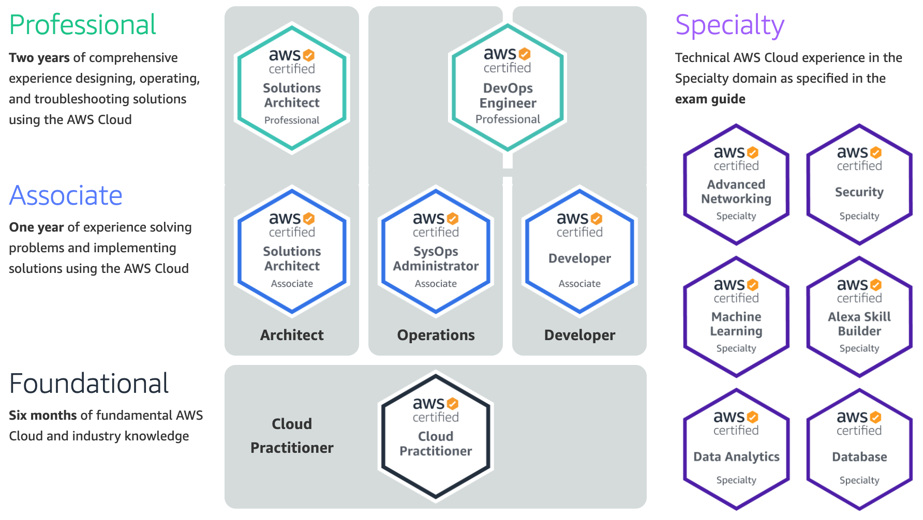
AWS Certification
2
SAA
1
CLF
https://aws.amazon.com/certification/

Slide 16
AWS Certified Cloud Practitioner (CLF-C01)
1
Source: https://aws.amazon.com/certification/certified-cloud-practitioner/

Slide 17
AWS Certified Solutions Architect – Associate (SAA-C02)
2
Source: https://aws.amazon.com/certification/certified-solutions-architect-associate

Slide 18
AWS Certified Cloud Practitioner
This certification provides individuals in a larger variety of cloud and technology roles with a way to validate their AWS Cloud knowledge and enhance their professional credibility.
This exam covers four domains, including cloud concepts, security, technology, and billing and pricing.
https://aws.amazon.com/certification/certified-cloud-practitioner/

Slide 19
AWS Certified Solutions Architect – Associate
This certification validates your ability to effectively demonstrate knowledge of how to architect and deploy secure and robust applications on AWS technologies.
This exam is for anyone with at least one year of hands-on experience designing available, cost-efficient, fault-tolerant, and scalable and distributed systems on AWS.
https://aws.amazon.com/certification/certified-solutions-architect-associate/

Slide 20
AWS Academy and Certifications
1
AWS Academy Cloud Foundations (ACF)
AWS Certified Cloud Practitioner (CLF-C01) (2021/05)
https://aws.amazon.com/certification/certified-cloud-practitioner/
AWS Academy Cloud Architecting (ACA)
AWS Certified Solutions Architect – Associate (SAA-C02)
https://aws.amazon.com/certification/certified-solutions-architect-associate/
2
https://aws.amazon.com/training/awsacademy/

Slide 21
AWS Academy and Certifications
1
AWS Academy Cloud Foundations (ACF)
AWS Certified Cloud Practitioner (CLF-C01) (2021/05)
https://aws.amazon.com/certification/certified-cloud-practitioner/
AWS Cloud Practitioner Essentials (Second Edition)
https://aws.amazon.com/training/course-descriptions/cloud-practitioner-essentials/
AWS Technical Essentials
https://aws.amazon.com/training/course-descriptions/essentials/
AWS Academy Cloud Architecting (ACA)
AWS Certified Solutions Architect – Associate (SAA-C02)
https://aws.amazon.com/certification/certified-solutions-architect-associate/
Architecting on AWS
https://aws.amazon.com/training/course-descriptions/architect/
2
https://aws.amazon.com/training/awsacademy/

Slide 22
AWS Certified Cloud Practitioner (CLF-C01)
Domain | % of Examination
Domain 1: Cloud Concepts | 26%
Domain 2: Security and Compliance | 25%
Domain 3: Technology | 33%
Domain 4: Billing and Pricing | 16%
TOTAL | 100%
Source: https://aws.amazon.com/certification/certified-cloud-practitioner/

Slide 23
AWS Certified Solutions Architect – Associate (SAA-C02)
Domain | % of Examination
Domain 1: Design Resilient Architectures | 30%
Domain 2: Design High-Performing Architectures | 28%
Domain 3: Specify Secure Applications and Architectures | 24%
Domain 4: Design Cost-Optimized Architectures | 18%
TOTAL | 100%
Source: https://aws.amazon.com/certification/certified-solutions-architect-associate

Slide 24
企業雲端運算入門 國立臺北大學企管系選修課程修課人數統計
SID | 科系 | 人數 | 百分比
1 | 企業管理學系 | 15 | 63%
2 | 金融與合作經營學系 | 3 | 13%
3 | 經濟學系 | 3 | 13%
4 | 應用外語學系 | 1 | 4%
5 | 會計學系 | 1 | 4%
6 | 休閒運動管理學系 | 1 | 4%
 | 合計 | 24 | 100%

Slide 25
AWS Educate Taiwan Cloud Ambassador Seeding Program (學生大使種子計畫)
Joyce Tseng (曾珈宜)
Department of Finance and Cooperative Management, National Taipei University (國立臺北大學金融與合作經營學系)
Cheng-Xun Zhou (周呈勳)
Department of Foreign Languages and Applied Linguistics, National Taipei University (國立臺北大學應用外語學系)

Slide 26
軟體工程 (Software Engineering)
雲端運算與雲軟體架構 (Cloud Computing and Cloud Software Architecture)
1091SE07
MBA, IM, NTPU (M5118) (Fall 2020) Tue 2, 3, 4 (9:10-12:00) (B8F40)
Min-Yuh Day
戴敏育
Associate Professor
副教授
Institute of Information Management, National Taipei University
國立臺北大學 資訊管理研究所
https://web.ntpu.edu.tw/~myday
2020-11-03

Slide 27
課程大綱 (Syllabus)
週次 (Week) 日期 (Date) 內容 (Subject/Topics)
1 2020/09/15 軟體工程概論 (Introduction to Software Engineering)
2 2020/09/22 軟體產品與專案管理：軟體產品管理，原型設計 (Software Products and Project Management: Software product management and prototyping)
3 2020/09/29 敏捷軟體工程：敏捷方法、Scrum、極限程式設計 (Agile Software Engineering: Agile methods, Scrum, and Extreme Programming)
4 2020/10/06 功能、場景和故事 (Features, Scenarios, and Stories)
5 2020/10/13 軟體架構：架構設計、系統分解、分散式架構 (Software Architecture: Architectural design, System decomposition, and Distribution architecture)
6 2020/10/20 軟體工程個案研究 I (Case Study on Software Engineering I)

Slide 28
課程大綱 (Syllabus)
週次 (Week) 日期 (Date) 內容 (Subject/Topics)
7 2020/10/27 基於雲的軟體：虛擬化和容器、軟體即服務 (Cloud-Based Software: Virtualization and containers, Everything as a service, Software as a service)
8 2020/11/03 雲端運算與雲軟體架構 (Cloud Computing and Cloud Software Architecture)
9 2020/11/10 期中報告 (Midterm Project Report)
10 2020/11/17 微服務架構：RESTful服務、服務部署 (Microservices Architecture, RESTful services, Service deployment)
11 2020/11/24 軟體工程產業實務 (Industry Practices of Software Engineering)
12 2020/12/01 安全和隱私 (Security and Privacy)

Slide 29
課程大綱 (Syllabus)
週次 (Week) 日期 (Date) 內容 (Subject/Topics)
13 2020/12/08 軟體工程個案研究 II (Case Study on Software Engineering II)
14 2020/12/15 可靠的程式設計 (Reliable Programming)
15 2020/12/22 測試：功能測試、測試自動化、 測試驅動的開發、程式碼審查 (Testing: Functional testing, Test automation, Test-driven development, and Code reviews)
16 2020/12/29 DevOps和程式碼管理： 程式碼管理和DevOps自動化 (DevOps and Code Management: Code management and DevOps automation)
17 2021/01/05 期末報告 I (Final Project Report I)
18 2021/01/12 期末報告 II (Final Project Report I)

Slide 30
Software Engineering and Project Management
Analyze
Requirements definition
Design
System and Software design
Build
Implementation and
unit testing
Test
Integration and system testing
Deliver
Operation and maintenance
Project Management

Slide 31
Outline
AWS雲端應用導入教學
課程理論中融入AWS概念
帶領學生進行雲端實作

Slide 32
課程理論中融入AWS概念
智慧金融量化分析 (Artificial Intelligence in Finance and Quantitative)
國立台北大學資管所碩士班 (Fall 2021)
人工智慧文本分析 (Artificial Intelligence for Text Analytics)
國立台北大學資管所碩士班 (Spring 2022)
人工智慧 (Artificial Intelligence)
國立台北大學資管所碩士班 (Spring 2021)
資料探勘 (Data Mining)
國立台北大學資管所碩士班 (Spring 2021) (電子商務碩士學分學程)
https://web.ntpu.edu.tw/~myday/teaching.htm

Slide 33

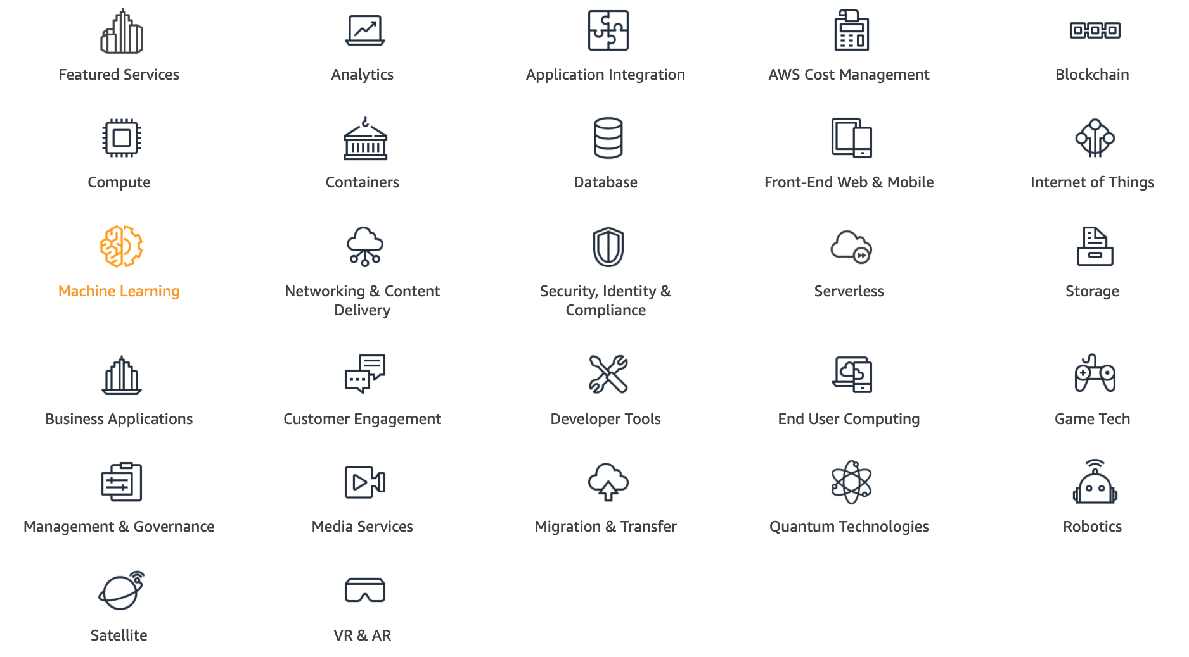
AWS Products and Services
Source: https://aws.amazon.com/

Slide 34
AWS Services
Amazon EC2
Virtual servers in the cloud
Amazon Simple Storage Service (S3)
Scalable storage in the cloud
Amazon Aurora
High performance managed relational database
Amazon DynamoDB
Managed NoSQL database
Amazon RDS
Managed relational database service for MySQL, PostgreSQL, Oracle, SQL Server, and MariaDB
Source: https://aws.amazon.com/

Slide 35
AWS Services
AWS Lambda
Run code without thinking about servers
AWS Elastic Beanstalk
Run and manage web apps
Amazon VPC
Isolated cloud resources
Amazon Lightsail
Launch and manage virtual private servers
Amazon SageMaker
Build, train, and deploy machine learning models at scale
Source: https://aws.amazon.com/

Slide 36
Outline
AWS雲端應用導入教學
課程理論中融入AWS概念
帶領學生進行雲端實作

Slide 37
帶領學生進行雲端實作
1. AWS Academy (Application: ntpu aws app)
(https://awsacademy.instructure.com/ , Vocareum Labs) 2. AWS Educate 3. AWS Free Tier 4. AWS Training 5. AWS Cloud Practitioner Essentials (Second Edition) 6. AWS Certified Cloud Practitioner 7. AWS Educate User Guide for Students 8. AWS Academy Cloud Foundations (ACF)
AWS_ACF_M01 ~ AWS_ACF_M10
https://web.ntpu.edu.tw/~myday/teaching.htm

Slide 38
AWS Serverless Architecture

Slide 39
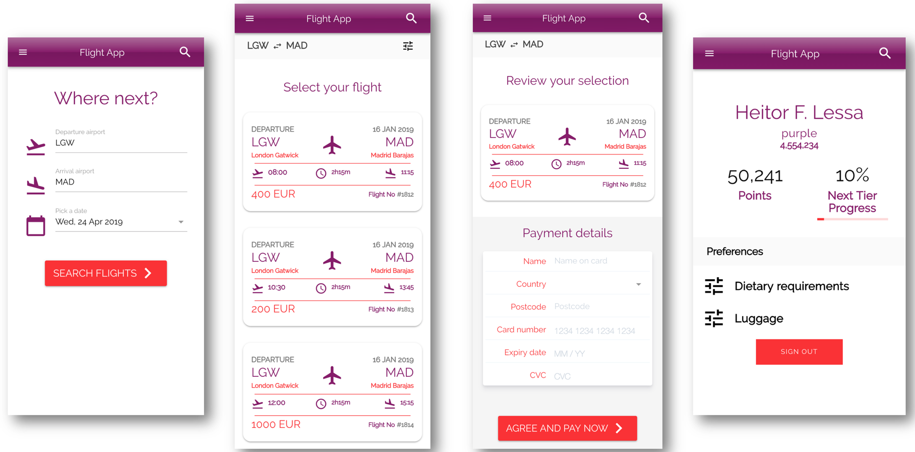
AWS Serverless Airline Booking
Source: https://github.com/aws-samples/aws-serverless-airline-booking

Slide 40
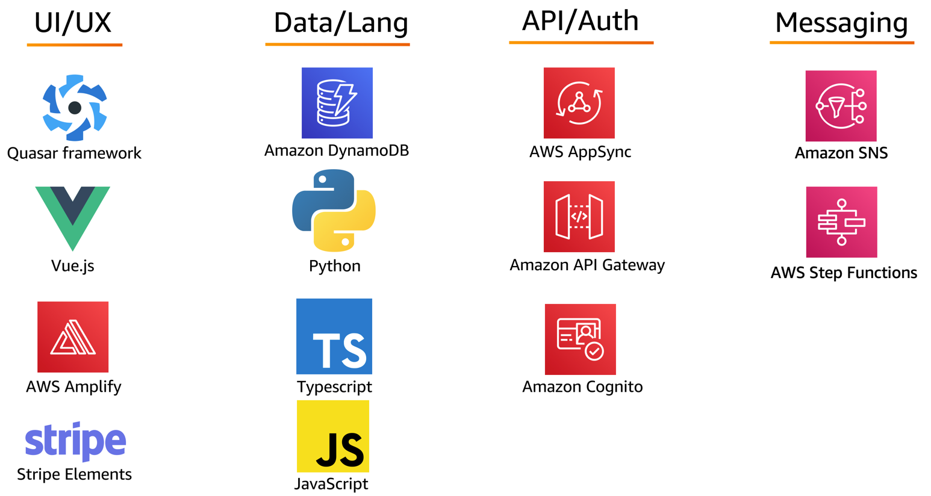
AWS Serverless Airline Booking Stack
Source: https://github.com/aws-samples/aws-serverless-airline-booking

Slide 41
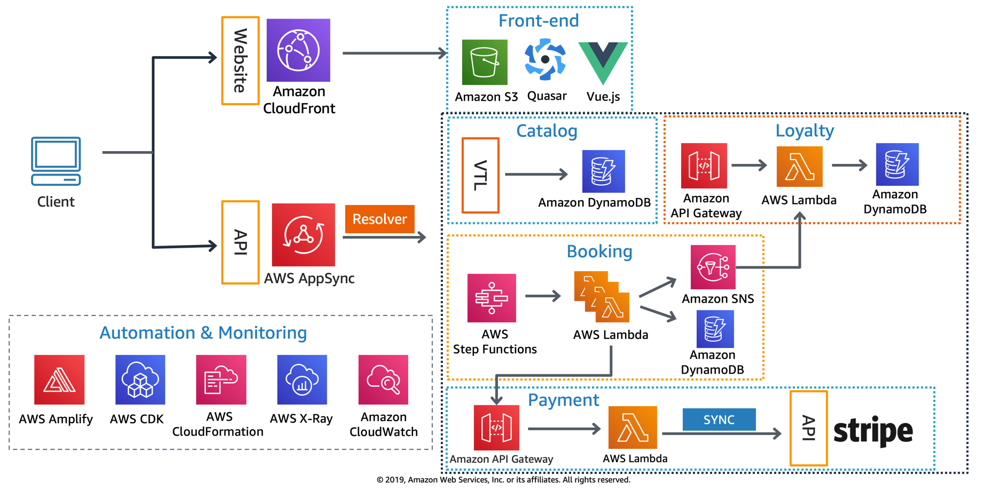
AWS Serverless Airline Booking High level infrastructure architecture
Source: https://github.com/aws-samples/aws-serverless-airline-booking

Slide 42
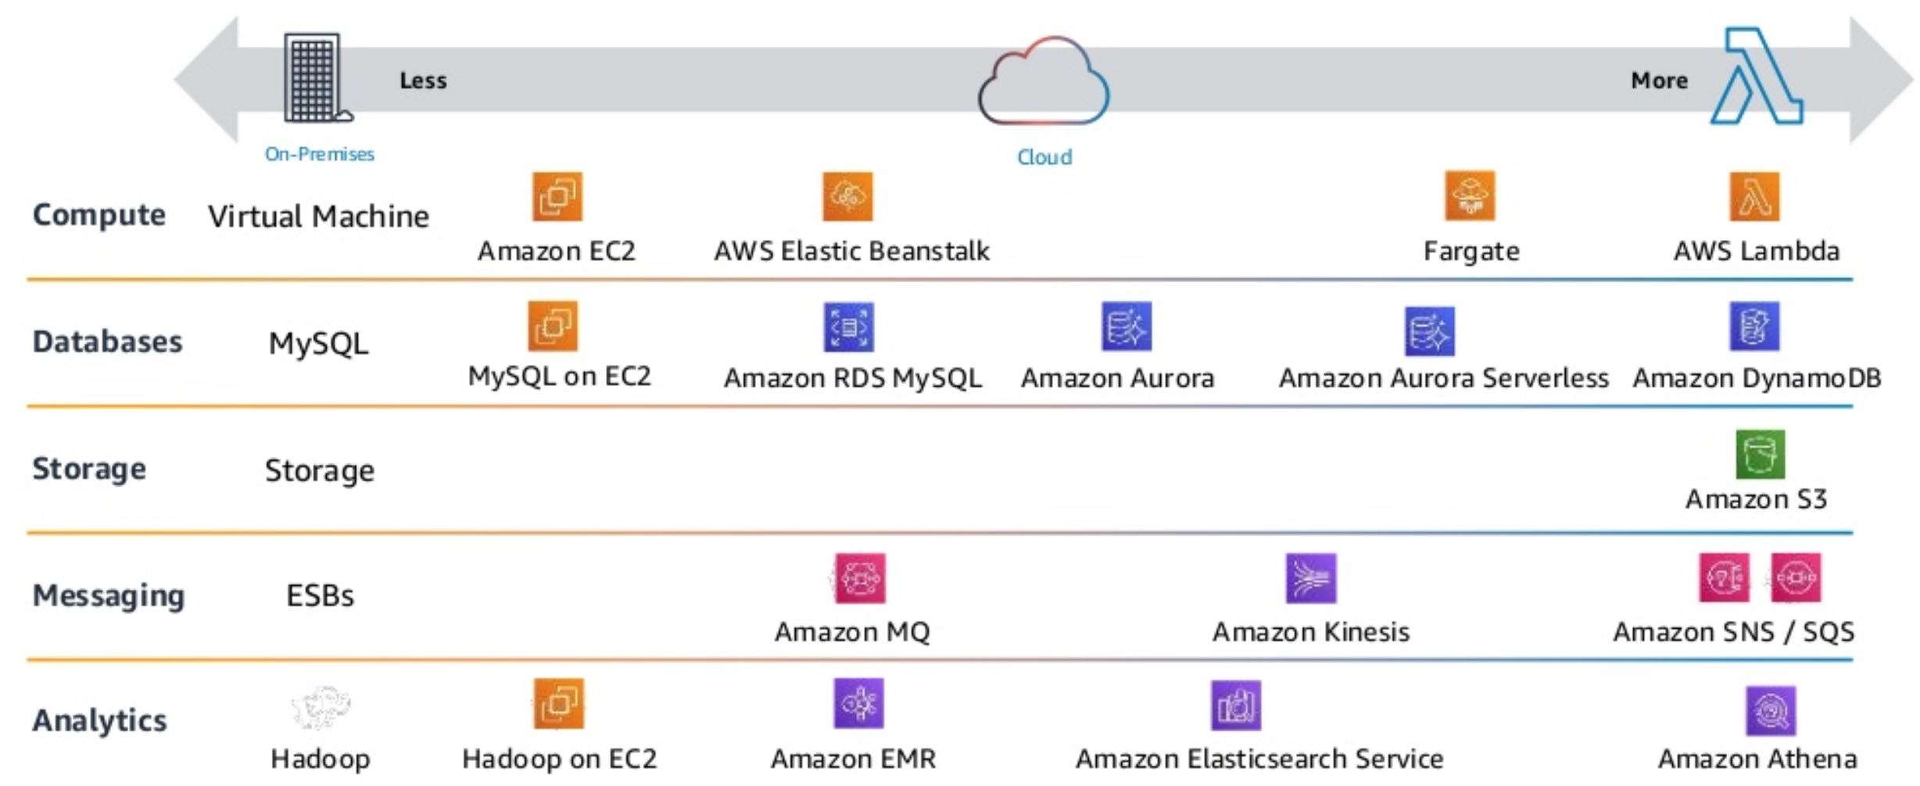
AWS Serverless Architecture AWS Operational Responsibility Models
Source: Heitor Lessa (2019), How to build a full stack serverless airline ticketing web app, https://www.youtube.com/watch?v=MyoOeHTp2pg

Slide 43
Build a Serverless Web Application

Slide 44
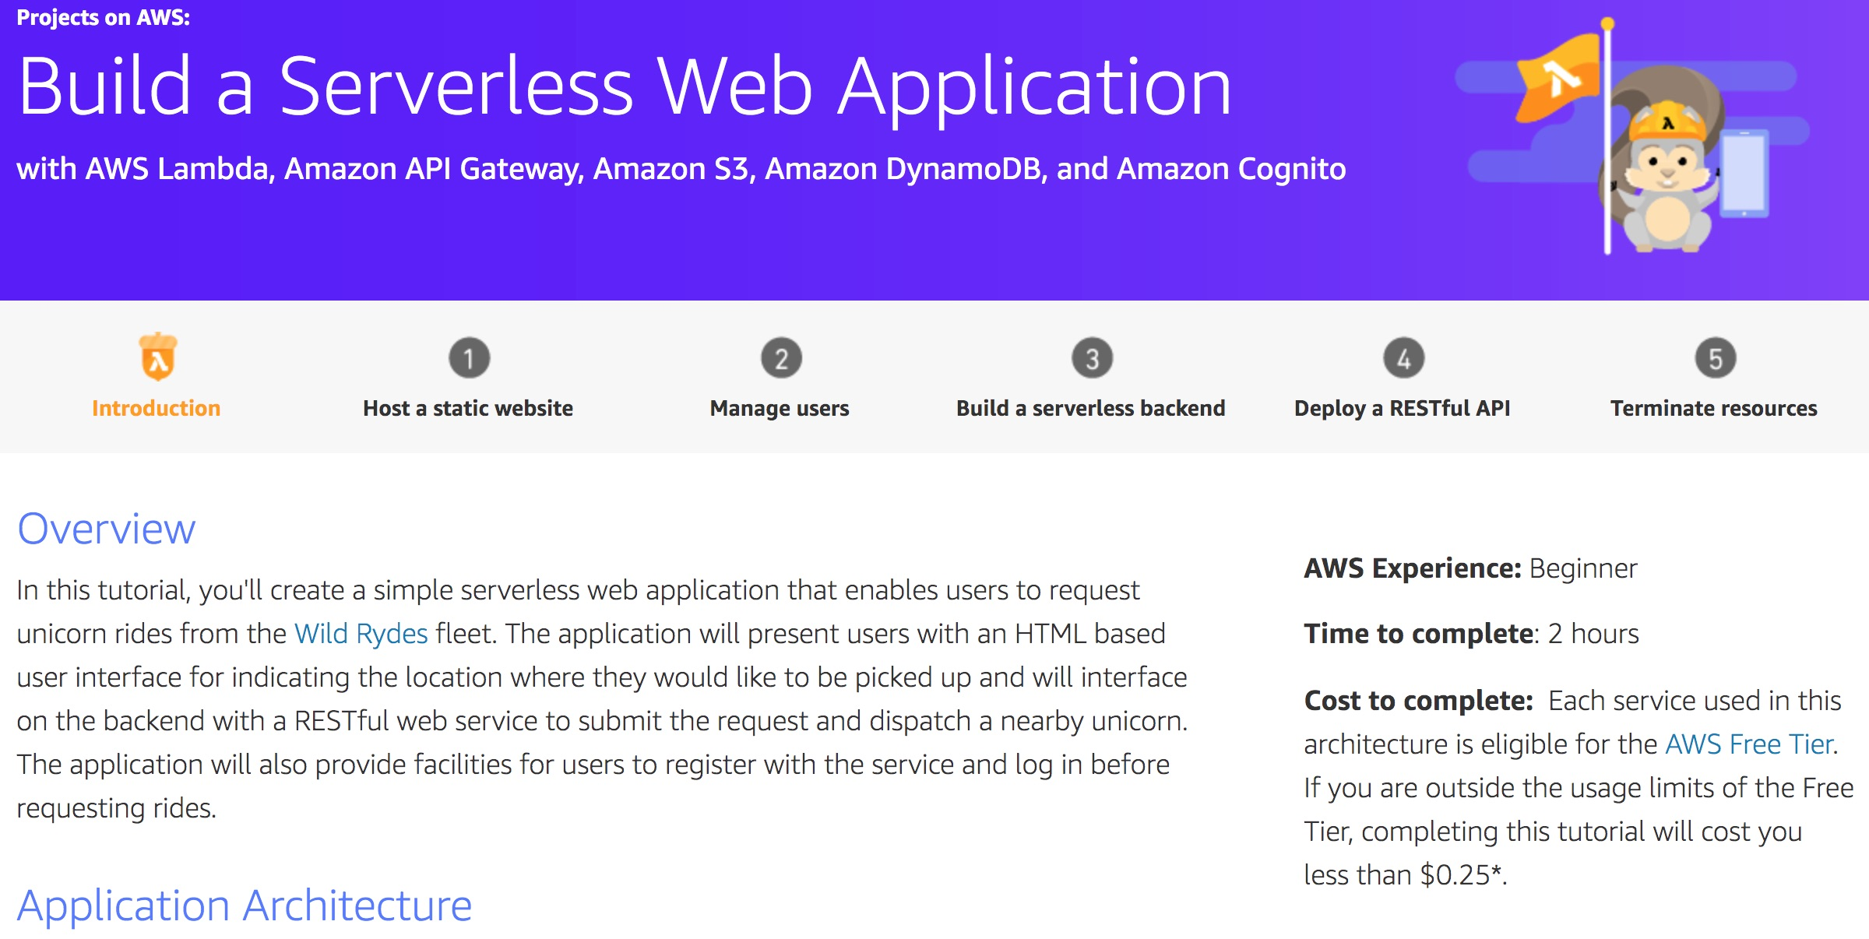
Build a Serverless Web Application
Source: https://aws.amazon.com/getting-started/projects/build-serverless-web-app-lambda-apigateway-s3-dynamodb-cognito/

Slide 45
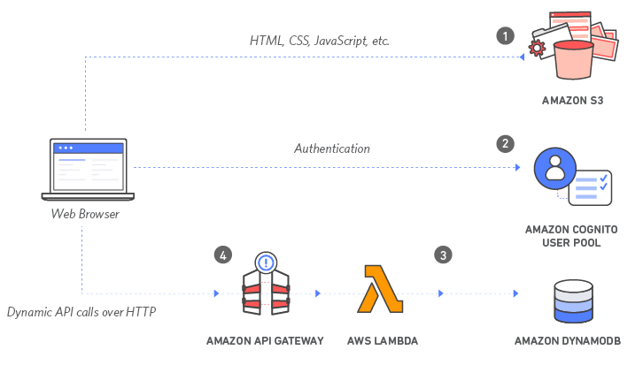
Build a Serverless Web Application with Amazon S3, AWS Lambda, Amazon API Gateway, Amazon DynamoDB, and Amazon Cognito
Source: https://aws.amazon.com/getting-started/projects/build-serverless-web-app-lambda-apigateway-s3-dynamodb-cognito/

Slide 46
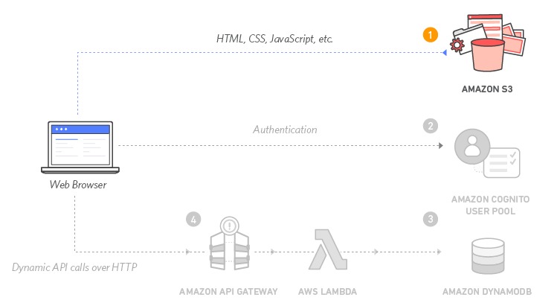
Build a Serverless Web Application with Amazon S3, AWS Lambda, Amazon API Gateway, Amazon DynamoDB, and Amazon Cognito
1
Source: https://aws.amazon.com/getting-started/projects/build-serverless-web-app-lambda-apigateway-s3-dynamodb-cognito/

Slide 47
Build a Serverless Web Application with Amazon S3, AWS Lambda, Amazon API Gateway, Amazon DynamoDB, and Amazon Cognito
1
Static Web Hosting
Amazon S3 hosts static web resources including HTML, CSS, JavaScript, and image files which are loaded in the user's browser.
Source: https://aws.amazon.com/getting-started/projects/build-serverless-web-app-lambda-apigateway-s3-dynamodb-cognito/

Slide 48
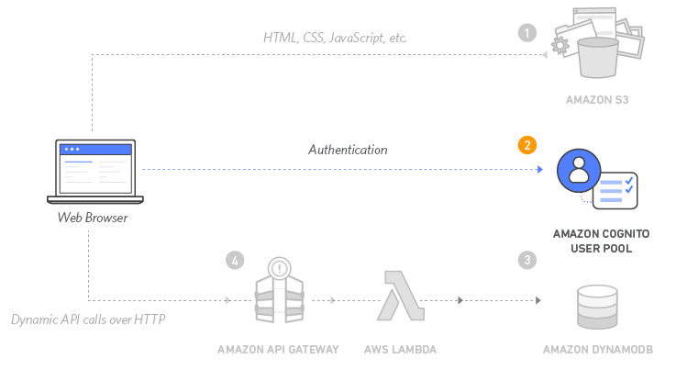
Build a Serverless Web Application with Amazon S3, AWS Lambda, Amazon API Gateway, Amazon DynamoDB, and Amazon Cognito
2
Source: https://aws.amazon.com/getting-started/projects/build-serverless-web-app-lambda-apigateway-s3-dynamodb-cognito/

Slide 49
Build a Serverless Web Application with Amazon S3, AWS Lambda, Amazon API Gateway, Amazon DynamoDB, and Amazon Cognito
2
User Management
Amazon Cognito provides user management and authentication functions to secure the backend API.
Source: https://aws.amazon.com/getting-started/projects/build-serverless-web-app-lambda-apigateway-s3-dynamodb-cognito/

Slide 50
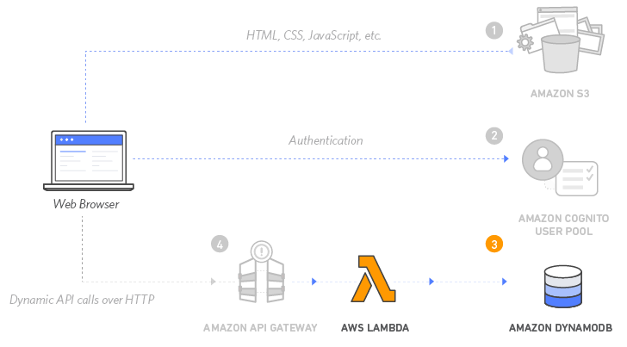
Build a Serverless Web Application with Amazon S3, AWS Lambda, Amazon API Gateway, Amazon DynamoDB, and Amazon Cognito
3
Source: https://aws.amazon.com/getting-started/projects/build-serverless-web-app-lambda-apigateway-s3-dynamodb-cognito/

Slide 51
Build a Serverless Web Application with Amazon S3, AWS Lambda, Amazon API Gateway, Amazon DynamoDB, and Amazon Cognito
3
Serverless Backend
Amazon DynamoDB provides a persistence layer where data can be stored by the API's Lambda function.
Source: https://aws.amazon.com/getting-started/projects/build-serverless-web-app-lambda-apigateway-s3-dynamodb-cognito/

Slide 52
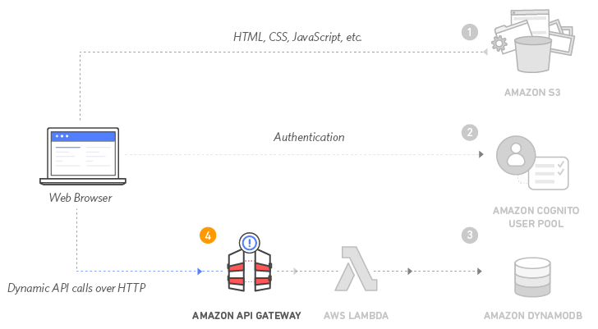
Build a Serverless Web Application with Amazon S3, AWS Lambda, Amazon API Gateway, Amazon DynamoDB, and Amazon Cognito
4
Source: https://aws.amazon.com/getting-started/projects/build-serverless-web-app-lambda-apigateway-s3-dynamodb-cognito/

Slide 53
Build a Serverless Web Application with Amazon S3, AWS Lambda, Amazon API Gateway, Amazon DynamoDB, and Amazon Cognito
4
RESTful API
JavaScript executed in the browser sends and receives data from a public backend API built using Lambda and API Gateway.
Source: https://aws.amazon.com/getting-started/projects/build-serverless-web-app-lambda-apigateway-s3-dynamodb-cognito/

Slide 54
Build a Serverless Web Application with Amazon S3, AWS Lambda, Amazon API Gateway, Amazon DynamoDB, and Amazon Cognito
5
Terminate resources
Resource Cleanup
You will terminate an Amazon S3 bucket, an Amazon Cognito User Pool, an AWS Lambda function, an IAM role, a DynamoDB table, a REST API, and a CloudWatch Log. It is a best practice to delete resources you are no longer using to avoid unwanted charges.
Source: https://aws.amazon.com/getting-started/projects/build-serverless-web-app-lambda-apigateway-s3-dynamodb-cognito/

Slide 55
Summary
AWS雲端應用導入教學
課程理論中融入AWS概念
帶領學生進行雲端實作

Slide 56
AWS Educate 2021 Q2 Online Educator Meetup
Q & A
AWS Academy 教學經驗分享
國立臺北大學企管系選修課程 (企業雲端運算入門)
(Teaching Experiences Sharing of Introducing AWS Academy at NTPU: Foundation of Business Cloud Computing)
Time: 2021/7/5 (Mon) 10:50-11:20 am
Host: AWS Educate
戴敏育 副教授
Min-Yuh Day, Ph.D, Associate Professor
國立臺北大學 資訊管理研究所
Institute of Information Management, National Taipei University
https://web.ntpu.edu.tw/~myday
2021-07-05

